Slide 1
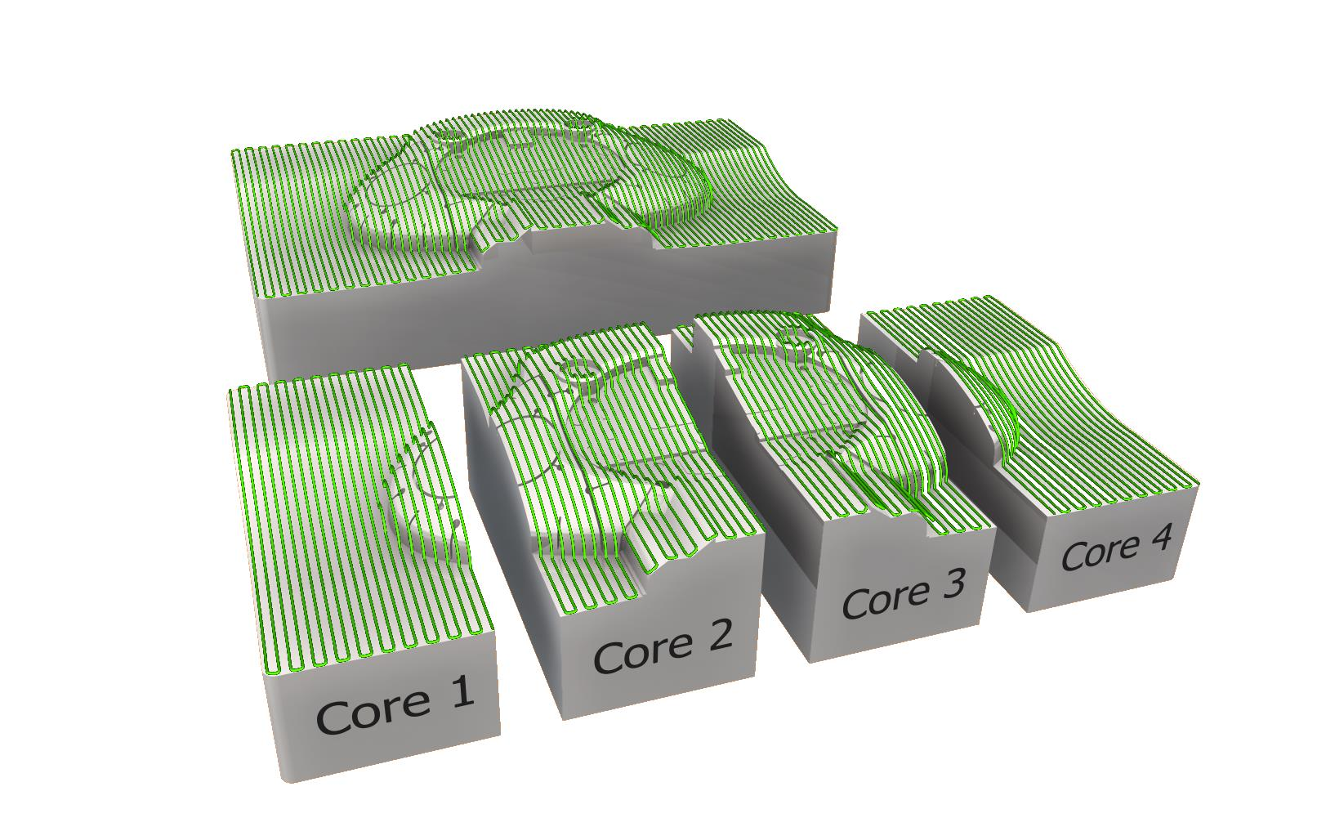
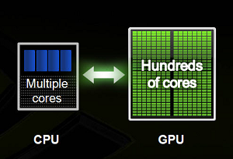
Parallel framework for author identification
Exploiting parallelism on CPU and GPU to train models in parallel
- Praveen Kulkarni

Slide 2
Introduction
Problem and Dataset
Model Fitting
Models Used
Discussion
Outlook
Parallelism
RBM (generative modelling)
Feature Ranking
Codebook vs feature
Different features
What next?

Slide 3
Introduction
Problem and Dataset
Model Fitting
Models Used
Discussion
Outlook
Parallelism
RBM (generative modelling)
Codebook vs feature
Different features
Feature Ranking
What next?

Slide 4

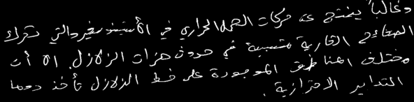


Introduction
Problem and Dataset
Codebook vs feature
Different features

Slide 5
Introduction
Problem and Dataset
Codebook vs feature
Different features
Codebook based
Based on graphemes
Methods differ based on segmentation techniques
Feature based
Based on geometrical, structural and textural features
Methods based on extracting different features and building PDF
Useful for less data
Needs more data

Slide 6
Introduction
Problem and Dataset
Codebook vs feature
Different features
Directions
Curvatures
Tortuosity
Chain code
Edge based directional

Slide 7
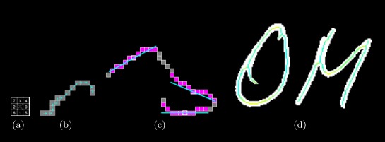
Introduction
Problem and Dataset
Codebook vs feature
Different features
Directions

Slide 8
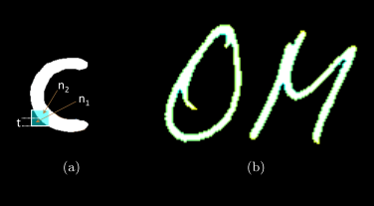
Introduction
Problem and Dataset
Codebook vs feature
Different features
Curvatures

Slide 9

Introduction
Problem and Dataset
Codebook vs feature
Different features
Tortuosity

Slide 10
Introduction
Problem and Dataset
Model Fitting
Models Used
Discussion
Outlook
Parallelism
RBM (generative modelling)
Codebook vs feature
Different features
Feature Ranking
What next?

Slide 11
Model Fitting
Models Used
Parallelism
RBM (generative modelling)
Direction features
Curvatures features
Classifier
Tortuosity features

Slide 12
Model Fitting
Models Used
Parallelism
RBM (generative modelling)
Features
F1
Classifier
1NN
Scores
0.82
F2
F3
….
F6272
LDA SVD
SVM
Extra Trees
Piped SVC LDA
0.85
0.80
0.85
0.87

Slide 13
Model Fitting
Models Used
Parallelism
RBM (generative modelling)
Combining Estimators
Feature Union
Composite feature spaces: Concatenating multiple feature extraction methods
Pipeline: chaining estimators
Example: PCA does an unsupervised dimensionality reduction, while the logistic regression does the prediction

Slide 14
Model Fitting
Models Used
Parallelism
RBM (generative modelling)
Features
CPU 0
SVM
CPU 1
LDA
CPU 2
1NN
CPU 3
RBM
CPU 4
ExtraTrees
GPU 0
RBM
Results

Slide 15
Model Fitting
Models Used
Parallelism
RBM (generative modelling)
Features
CPU 0
CPU 1
CPU 2
CPU 3
CPU 4
Generative model (RBM)
Linear Discriminant Analysis (LDA)
Results

Slide 16
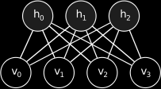
Model Fitting
Models Used
Parallelism
RBM (generative modelling)
Features
F1
RBM (hidden units)
8000
LDA
F2
F3
….
F6272
6272
4000
2000
Scores
0.89
0.88
0.88
0.87

Slide 17
Introduction
Problem and Dataset
Model Fitting
Models Used
Discussion
Outlook
Parallelism
RBM (generative modelling)
Feature Ranking
Codebook vs feature
Different features
What next?

Slide 18
Discussion
Outlook
Feature Ranking
What next?
Trying different classifiers
Combining estimators
Unsupervised learning
Feature Union
Chaining estimators
RBM
Parallel framework
Exploit multi cores on CPU and GPU to train models in parallel

Slide 19
Discussion
Outlook
Feature Ranking
What next?

Slide 20
Discussion
Outlook
Feature Ranking
What next?

Slide 21
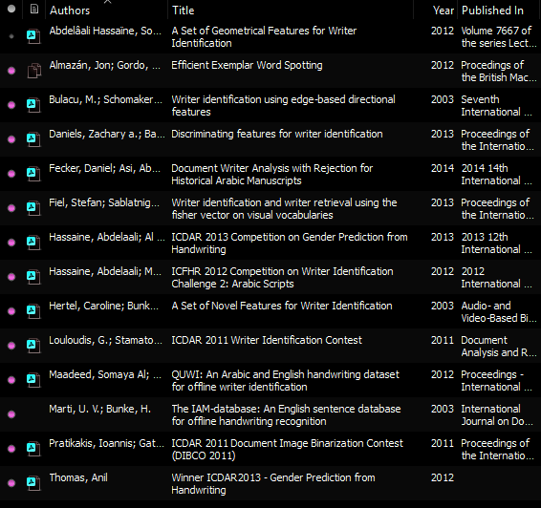


danke !

